Slide 1
WordPress for Beginners
July 2013
Leonard Nelson

Slide 2
Open Questions

Slide 3
Course Material
http://www.leonelson.com/wordpress/

Slide 4
Review Lesson 1

Slide 5
Get Involved – Pick the right name
Wordpress
WORDPRESS
WordPress
wordpress

Slide 6
Where can I get WordPress from?
Download from WordPress.org

Slide 7
Where can I run WordPress?
Hosting Provider
WordPress.com

Slide 8
WordPress.com vs. Hosting Provider
Installation

Slide 9
WordPress.com
Installed and hosted for you
Hosting Provider
Installed and hosted by yourself
Notes:
Example: Shopping Cart, Style, PHP Code, Plugins
Source: http://en.support.wordpress.com/com-vs-org/

Slide 10
WordPress.com vs. Hosting Provider
Domain Name

Slide 11
WordPress.com
Free Sub Domain Name
Free Advertising
$13 per year for Automattic to allow this feature
$15 per year to buy domain name
Hosting Provider
$15 per year to buy domain name*
Notes:
Example: Shopping Cart, Style, PHP Code, Plugins
Source: http://en.support.wordpress.com/com-vs-org/

Slide 12
WordPress.com vs. Hosting Provider
Storage

Slide 13
WordPress.com
3 GB of storage for free
10 GB of storage for $20 per year
Hosting Provider
$60 per year to buy unlimited hosting space*
Notes:
Example: Shopping Cart, Style, PHP Code, Plugins
Source: http://en.support.wordpress.com/com-vs-org/

Slide 14
WordPress.com vs. Hosting Provider
Software Updates

Slide 15
WordPress.com
Free updates installed for you
Hosting Provider
Free updates available
You install it yourself
Hosting provider installs it for you*
Notes:
Example: Shopping Cart, Style, PHP Code, Plugins
Source: http://en.support.wordpress.com/com-vs-org/

Slide 16
WordPress.com vs. Hosting Provider
Features

Slide 17
Features
Functionality of software

Slide 18
WordPress.com
Less control over features …
Hosting Provider
More control over features …
Notes:
Example: Shopping Cart, Style, PHP Code, Plugins
Source: http://en.support.wordpress.com/com-vs-org/

Slide 19
Features

Slide 20
WordPress Features
Plugins - Tools to extend the functionality of WordPress
Themes - Control the look and presentation of the material or content on your website

Slide 21
WordPress Features : Plugins
Notes:
Extends the functionality of a WordPress site

Slide 22
WordPress.com vs. Hosting Provider
Plugins

Slide 23
WordPress.com
You can’t upload plugins
Hosting Provider
Ability to upload plugins
Notes:
Example: Shopping Cart, Style, PHP Code, Plugins
Source: http://en.support.wordpress.com/com-vs-org/

Slide 24
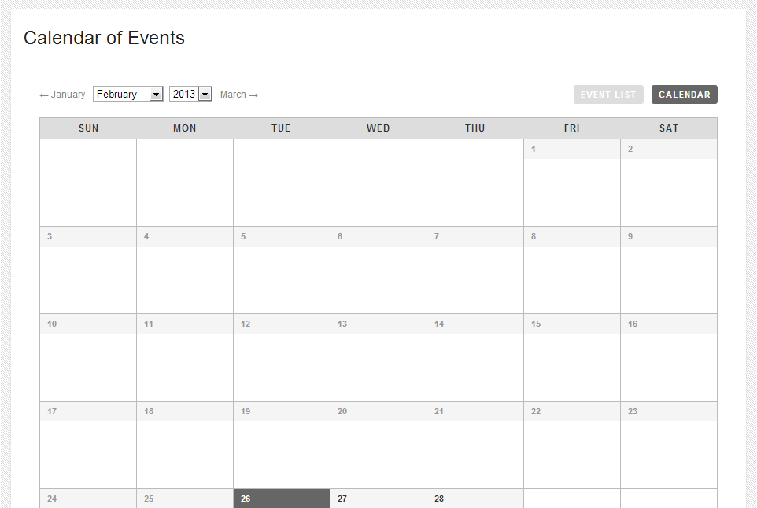

Slide 26
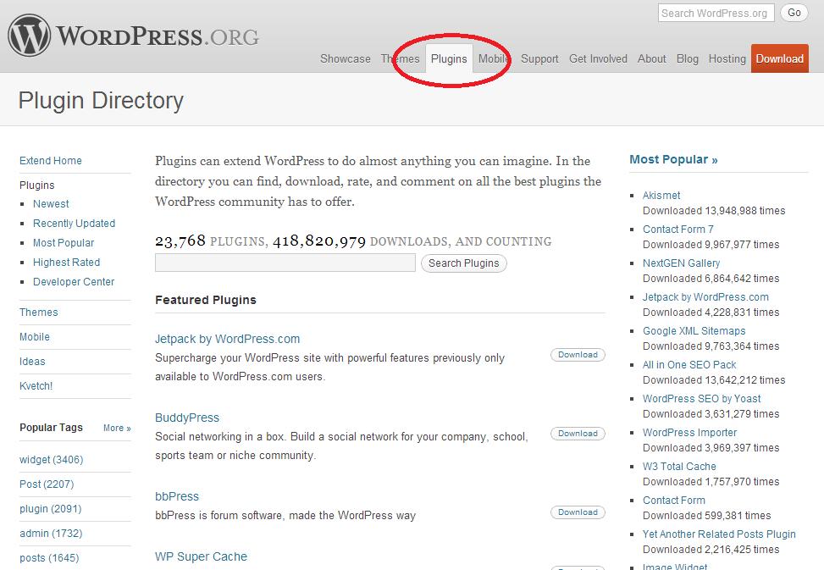

Slide 27
WordPress Features : Themes
Notes:
kges the look and pyhnnresentation of your siteg

Slide 28
WordPress.com vs. Hosting Provider
Themes

Slide 29
WordPress.com
210+ themes which you can customize, but you cannot upload a custom theme
Hosting Provider
Ability to upload custom themes
Notes:
Example: Shopping Cart, Style, PHP Code, Plugins
Source: http://en.support.wordpress.com/com-vs-org/

Slide 30
Appearance > Themes
Notes:
kges the look and pyhnnresentation of your siteg

Slide 31
Appearance > Widgets
Notes:
kges the look and pyhnnresentation of your siteg

Slide 32
Appearance > Menus
Notes:
kges the look and pyhnnresentation of your siteg

Slide 33
Appearance > Header
Notes:
kges the look and pyhnnresentation of your siteg

Slide 34
Appearance > Background
Notes:
kges the look and pyhnnresentation of your siteg

Slide 35
Appearance > Custom Design
Notes:
kges the look and pyhnnresentation of your siteg

Slide 36
Appearance > Mobile
Notes:
kges the look and pyhnnresentation of your siteg

Slide 37
WordPress.com vs. WordPress.org

Slide 38
WordPress.com
WordPress software is installed and hosted for you
WordPress.org
Download the WordPress software
Download WordPress plugins
Download WordPress themes
Download the WordPress mobile applications
Get support for WordPress
Get involved with WordPress
Read documentation for WordPress
Notes:
Example: Shopping Cart, Style, PHP Code, Plugins
Source: http://en.support.wordpress.com/com-vs-org/

Slide 39
Get Involved – How did I do?
Student Evaluation

Slide 40
Get Involved – Putting it all together

Slide 41
Questions/ Feedback
https://www.leonelson.com/

